Slide 1
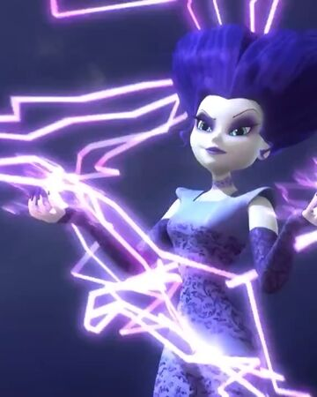
The Motor Principle – Mar 13 (Electricity & Magnetism Day 17)
Agenda
Lenz’s Law – Magnetic Induction:
Activity: Induction Investigation
Motor Principle / Magnetic Force
Presentation: The Motor Principle
Right Hand Rule #3
Magnetism Worksheet 3
Upcoming
When we get back (April 5?)
Monday: Electric Motors Activity
Tuesday: Magnetism Review
Wednesday: Magnetism Quest

